Slide 1

<
Quality Assurance in Higher Education: Issues and the Way Forward
Dr. Noel B. Saliu
Director of Accreditation
National Universities Commission
CODAPNU 2018 Conference and Workshop
15 October, 2018

Slide 2

Appreciation
National Universities Commission

Slide 3


Slide 4
Theme:
Ensuring Quality and Best Practices in Higher Education: The Role of Academic Planning

Slide 5
Quality Assurance ……Overview

Slide 6




Concept of Quality
A
B
C
Is beauty in the eye of the beholder?

Slide 7
Quality is …general standard or grade

Slide 8
Assurance: The act of giving confidence, the state of being certain or the act of making certain

Slide 9
Quality + Assurance

Slide 10
Quality Assurance
A set of planned and systematic activities implemented to maximise the probability that minimum standards of quality in education are being attained.

Slide 11

Accreditation
Quality assurance is not only accreditation

Slide 12
Elements of Quality Assurance
External examiner system
Institutional audit/visitations
Routine monitoring
Accreditation
Ranking
Post-UTME
…

Slide 13
Purpose of Quality Assurance
Provision of information to the public and other interested parties about quality and standards
Giving credibility to awards (and hence to award holders).
Engendering of confidence in purchasers that they will be making a worthwhile investment when they enroll in a programme
Ensuring accountability in respect of the investment of public money
Providing clarity regarding the purpose of programmes, and
Enhancing quality and standards

Slide 14
Nigerian’s Tertiary Education System

Slide 15
Today…
43 Federal
165 Universities 47 State
75 Private
National Universities Commission

Slide 16
28 Federal
114 Polytechnics 41 State
45 Private
National Universities Commission

Slide 17
22 Federal
47 State
17 Private
114 Colleges of
Education
National Universities Commission

Slide 18
Education
Concurrent
Q.A
Exclusive

Slide 19
QA Agencies
NUC
Universities
NBTE
Polytechnics
NCCE
Colleges of Education

Slide 20
Q.A
External
Internal

Slide 21


National Universities Commission

Slide 22
NUC…Established in 1962
Became a Statutory Organisation in 1974
Overall mandate is to ensure the orderly development of university education in Nigeria
At Establishment of
NUC Universities - 5
Statutory body - 6 Universities
By 1975 - 13 Universities

Slide 23
NUC’s Q.A. System
NUC Q.A. System
Accreditation
Establishment of Universities
COMPU
Programme Establishment
Curriculum Development
Admission Quota
Post-UTME Screening
Physical Planning Development
Research and Innovation

Slide 24
Issues

Slide 25
Issues
Teaching
Curriculum
Actual teaching
Students Evaluation
Capacity building
Research
Quality of Research
Publication
Multidisciplinarity/transdisciplinarity

Slide 26
Issues
Community Service/Engagement
Lack of strong IQA mechanism to complement the EQA
Inaccurate Data
Overlap of accreditation of professional bodies

Slide 27
Way Forward

Slide 28
Strong I.Q.A
Strong I.Q.A
Strong I.Q.A
Strong I.Q.A
Strong I.Q.A
Strong I.Q.A
Strong I.Q.A
Strong I.Q.A
Strong I.Q.A
Strong I.Q.A
Strong I.Q.A
Strong I.Q.A

Slide 29
Benefits of Strong Internal Q.A
Timely, efficient and progressive performance of academic, administrative and financial tasks.
The relevance and quality of academic and research programmes.
Equitable access to and affordability of academic programmes for various sections of society.
Optimization and integration of modern methods of teaching and learning.

Slide 30
The credibility of evaluation procedures.
The adequacy, maintenance and proper allocation of support structure and services.
Research sharing and networking with other institutions within and abroad.
Monitor the implementation of the University strategic plan.
Developing the University’s Quality Assurance policy.

Slide 31
Coordinating Students' Evaluation of staff and programmes.
Encouraging self-assessment of teaching staff.
Coordinating internal and external assessment of programmes and institution as a whole.
Organizing seminars, workshops and conferences on quality assurance to create the culture of quality assurance in the system.

Slide 32
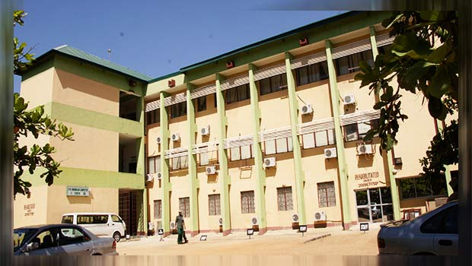
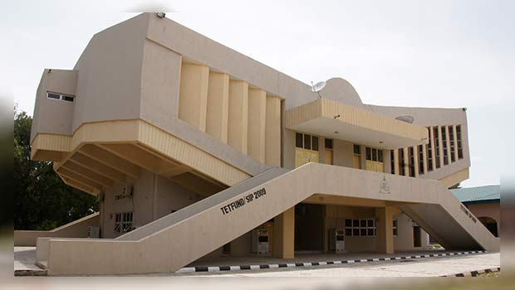
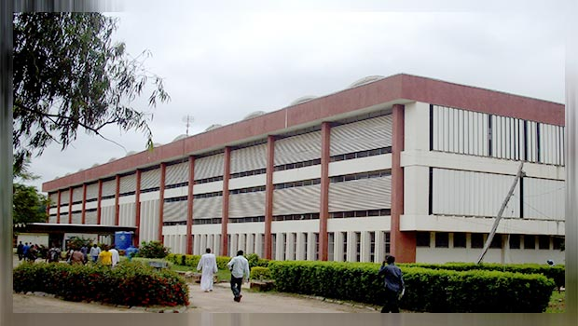
By default…..
Universities are Q. A. Institutions
Campuses under Olabisi Onabanjo

Slide 33
Conclusion
Giant strides in university Q.A require strong internal quality assurance at the institutional levels and strong external quality assurance systems.
No matter how strong the external Q.A, if the internal mechanism is weak, university development will be hampered.
External Q.A relies on Internal Q.A.
The demand for university education will continue to increase
Q.A. must always be at the front in HEIs

Slide 34
Thank you
nbsaliu@nuc.edu.ng
remibiodun2000@yahoo.com
www.nuc.edu.ng

